Slide 1
Edges
CSC 249/449 Spring 2018
http://www.cs.rochester.edu/~cxu22/t/249S18/
Instructor: Chenliang Xu
chenliang.xu@rochester.edu

Slide 2
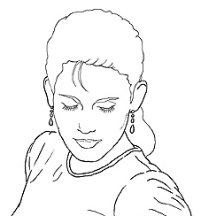
Edge detection
Goal: map image from 2d array of pixels to a set of curves or line segments or contours.
Why?
Main idea: look for strong gradients, post-process
Figure from J. Shotton et al., PAMI 2007
Slide credit: Kristen Grauman

Slide 3
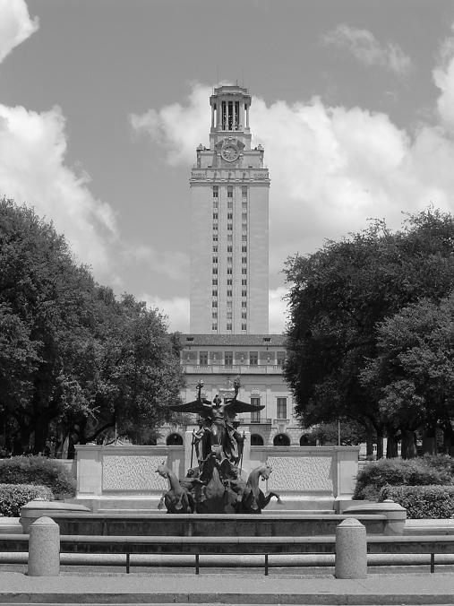
What causes an edge?
Depth discontinuity: object boundary
Reflectance change: appearance information, texture
Cast shadows
Change in surface orientation: shape
Slide credit: Kristen Grauman

Slide 4
Edges/gradients and invariance
Slide credit: Kristen Grauman

Slide 5

Edge detection
An edge is a place of rapid change in the image intensity function
intensity function (along horizontal scanline)
image
first derivative
edges correspond to extrema of derivative
Source: S. Lazebnik

Slide 6
Derivatives with convolution
For 2D function f(x,y), the partial derivative is:
For discrete data, we can approximate using finite differences:
To implement the above as convolution, what would be the associated filter?
Source: K. Grauman

Slide 7
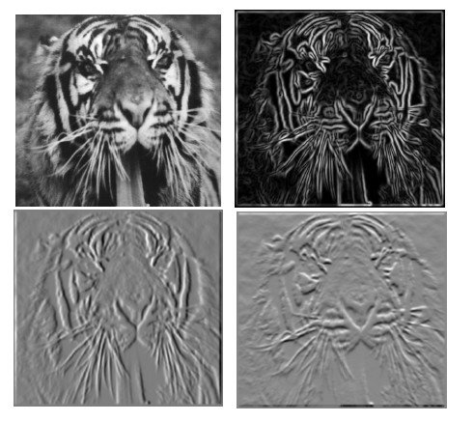
Partial derivatives of an image
?
-1 1
1 -1
-1 1
or
Which shows changes with respect to x?
(showing filters for correlation)

Slide 8

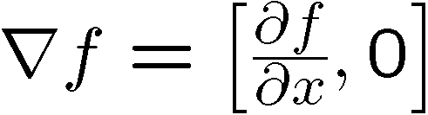

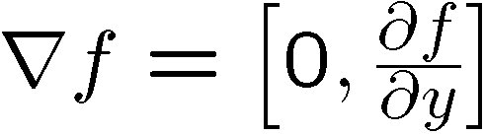
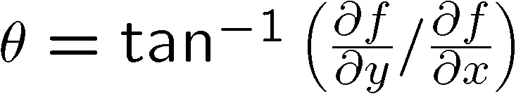
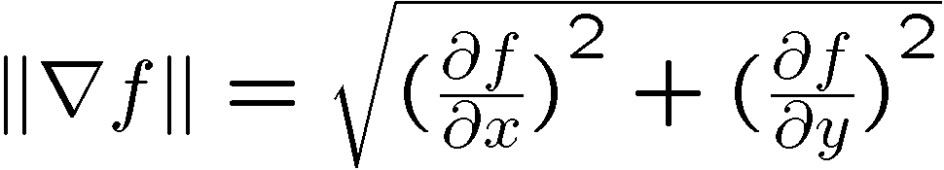
Image gradient
The gradient of an image:
The gradient points in the direction of most rapid increase in intensity
How does this direction relate to the direction of the edge?
The gradient direction is given by
The edge strength is given by the gradient magnitude
Source: Steve Seitz

Slide 9
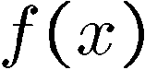
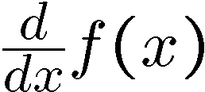
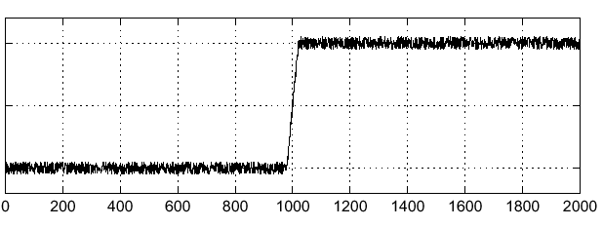
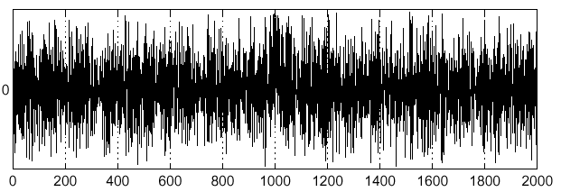
Effects of noise
Consider a single row or column of the image
Plotting intensity as a function of position gives a signal
Where is the edge?
Slide credit Steve Seitz

Slide 10


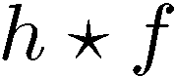
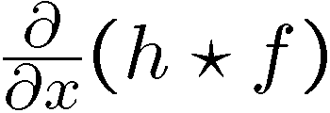
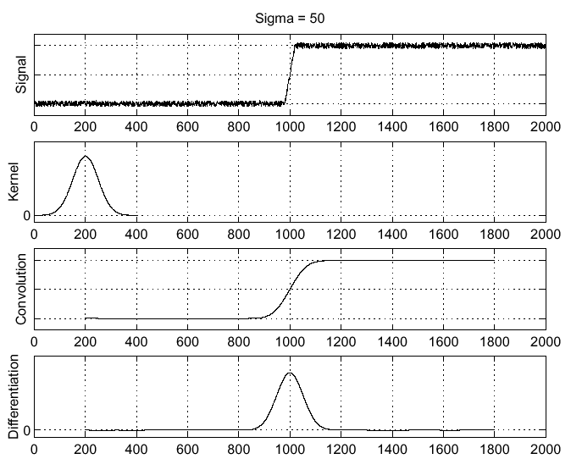
Solution: smooth first
Where is the edge?
Look for peaks in

Slide 11
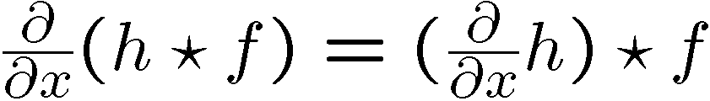
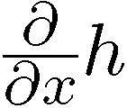
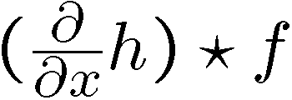
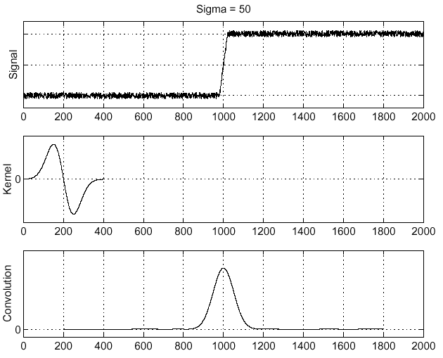
Derivative theorem of convolution
Differentiation property of convolution.
Slide credit Steve Seitz

Slide 12
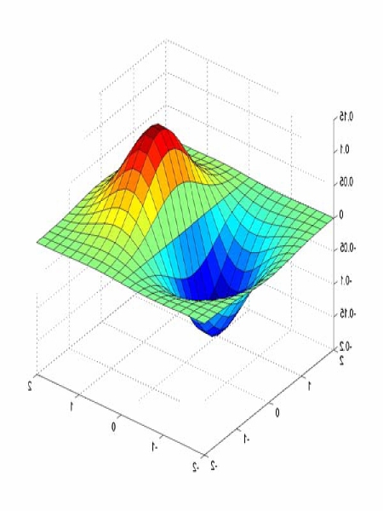
Derivative of Gaussian filters
0.0030 0.0133 0.0219 0.0133 0.0030
0.0133 0.0596 0.0983 0.0596 0.0133
0.0219 0.0983 0.1621 0.0983 0.0219
0.0133 0.0596 0.0983 0.0596 0.0133
0.0030 0.0133 0.0219 0.0133 0.0030

Slide 13
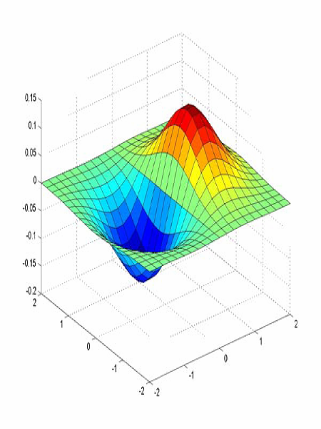
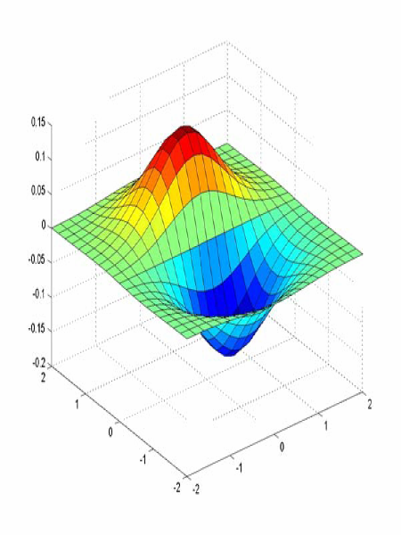
Derivative of Gaussian filters
x-direction
y-direction
Source: L. Lazebnik

Slide 14
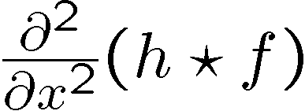
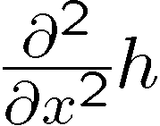
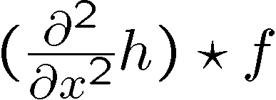
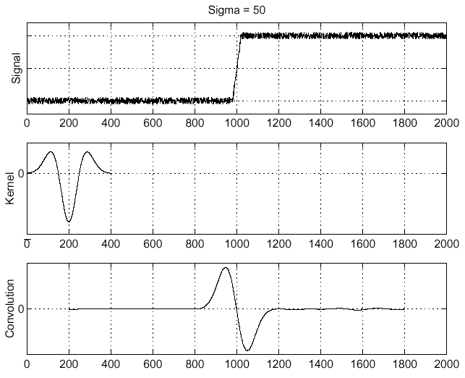
Laplacian of Gaussian
Consider
Laplacian of Gaussian
operator
Where is the edge?
Zero-crossings of bottom graph
Slide credit: Steve Seitz

Slide 15
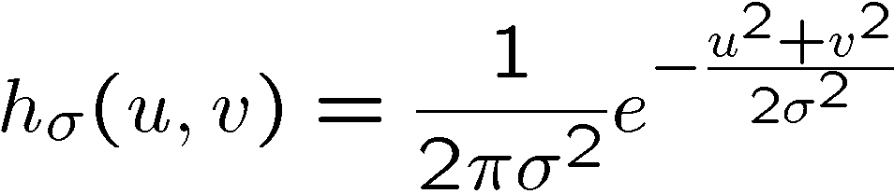
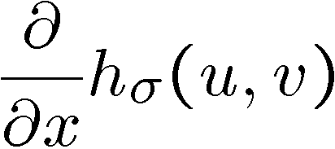
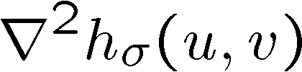
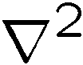
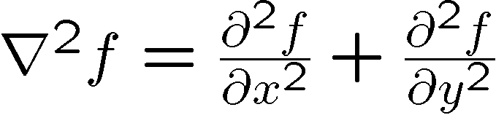
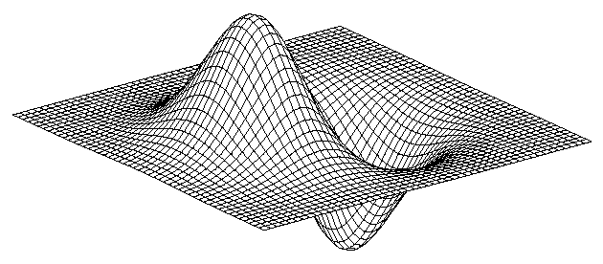
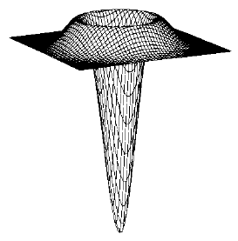
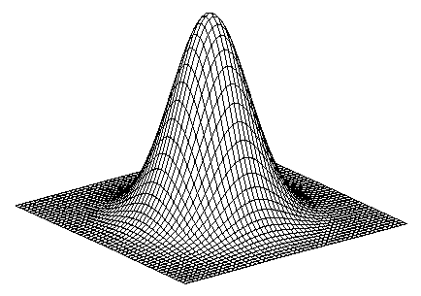
2D edge detection filters
Laplacian of Gaussian
Gaussian
derivative of Gaussian
is the Laplacian operator:
Slide credit: Steve Seitz
Notes:
15

Slide 16
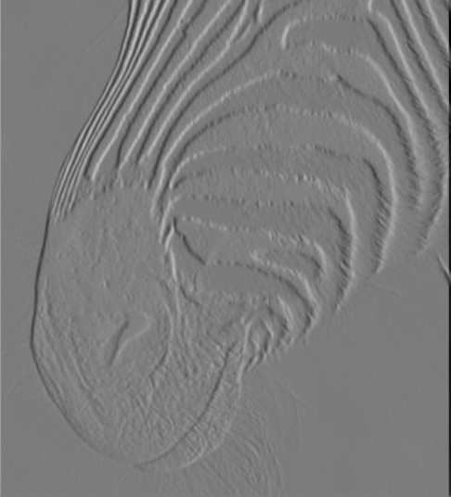
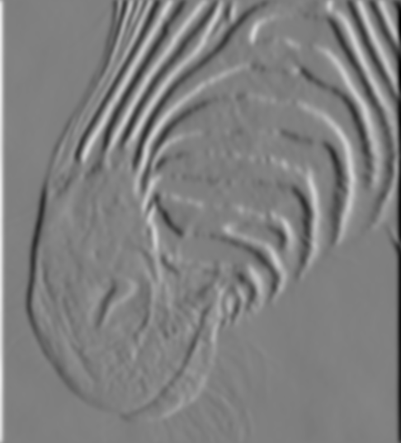
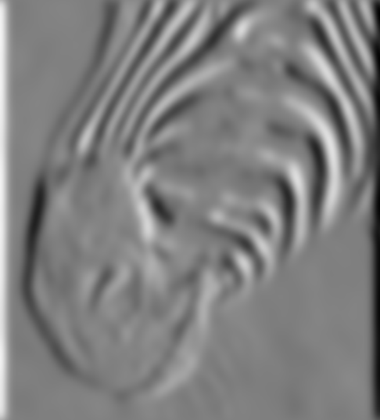
Scale of Gaussian derivative filter
1 pixel
3 pixels
7 pixels
Smoothed derivative removes noise, but blurs edge. Also finds edges at different “scales”
Source: D. Forsyth

Slide 17
Review: Smoothing vs. derivative filters
Smoothing filters
Gaussian: remove “high-frequency” components; “low-pass” filter
Can the values of a smoothing filter be negative?
What should the values sum to?
One: constant regions are not affected by the filter
Derivative filters
Derivatives of Gaussian
Can the values of a derivative filter be negative?
What should the values sum to?
Zero: no response in constant regions
High absolute value at points of high contrast

Slide 18
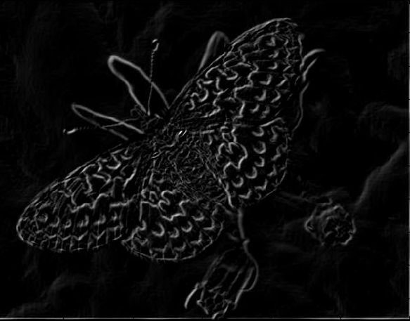
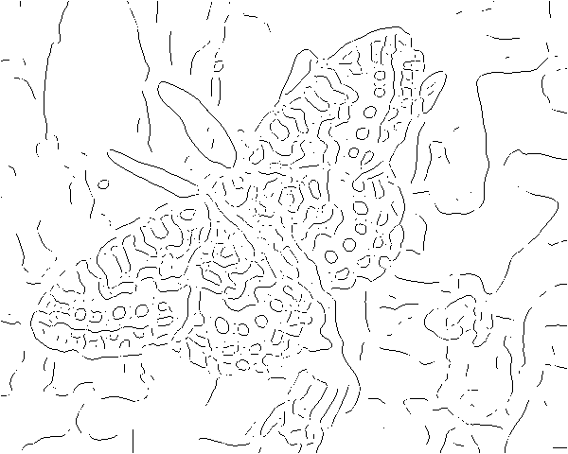
Gradients -> edges
Primary edge detection steps:
1. Smoothing: suppress noise
2. Edge enhancement: filter for contrast
3. Edge localization
Determine which local maxima from filter output are actually edges vs. noise
Threshold, Thin

Slide 19
Thresholding
Choose a threshold value t
Set any pixels less than t to zero (off)
Set any pixels greater than or equal to t to one (on)

Slide 20
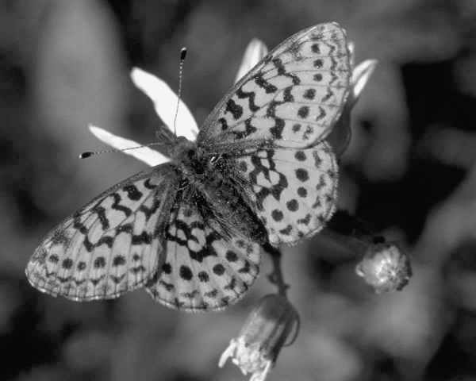
Original image

Slide 21
Gradient magnitude image

Slide 22
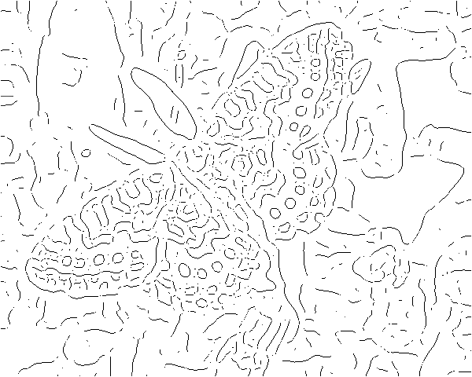
Thresholding gradient with a lower threshold

Slide 23
Thresholding gradient with a higher threshold

Slide 24
Canny edge detector
Filter image with derivative of Gaussian
Find magnitude and orientation of gradient
Non-maximum suppression:
Thin wide “ridges” down to single pixel width
Linking and thresholding (hysteresis):
Define two thresholds: low and high
Use the high threshold to start edge curves and the low threshold to continue them
MATLAB: edge(image, ‘canny’);
>>help edge
Source: D. Lowe, L. Fei-Fei

Slide 25

The Canny edge detector
original image (Lena)
Slide credit: Steve Seitz

Slide 26
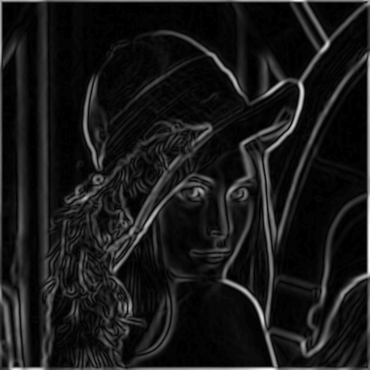
The Canny edge detector
norm of the gradient
Slide credit: Steve Seitz

Slide 27
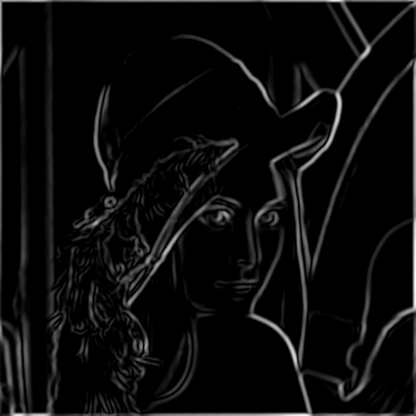
The Canny edge detector
thresholding
Slide credit: Steve Seitz

Slide 28
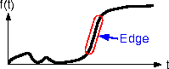
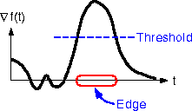
The Canny edge detector
How to turn these thick regions of the gradient into curves?
thresholding
Slide credit: Steve Seitz

Slide 29

Non-maximum suppression
Check if pixel is local maximum along gradient direction, select single max across width of the edge
requires checking interpolated pixels p and r
Slide credit: Steve Seitz

Slide 30
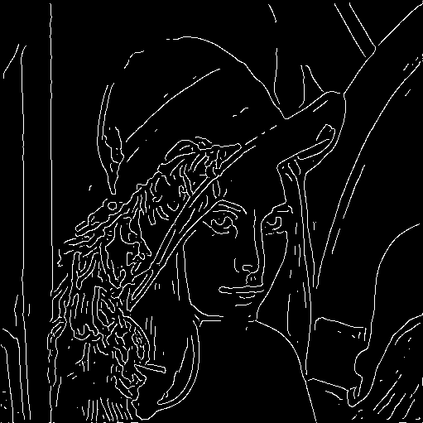
The Canny edge detector
Problem: pixels along this edge didn’t survive the thresholding
thinning
(non-maximum suppression)
Slide credit: Steve Seitz

Slide 31
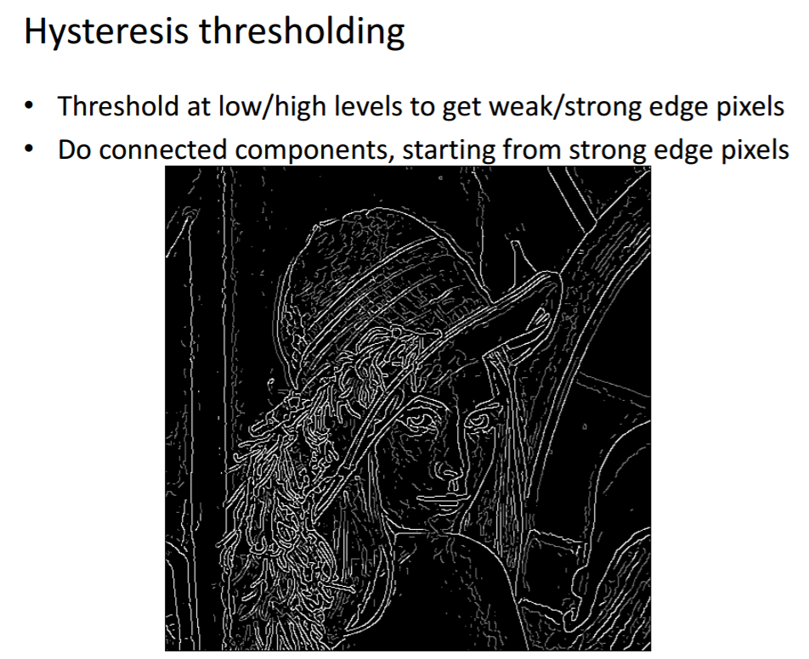
Credit: James Hays

Slide 32
Hysteresis thresholding
Use a high threshold to start edge curves, and a low threshold to continue them.
Source: Steve Seitz

Slide 33
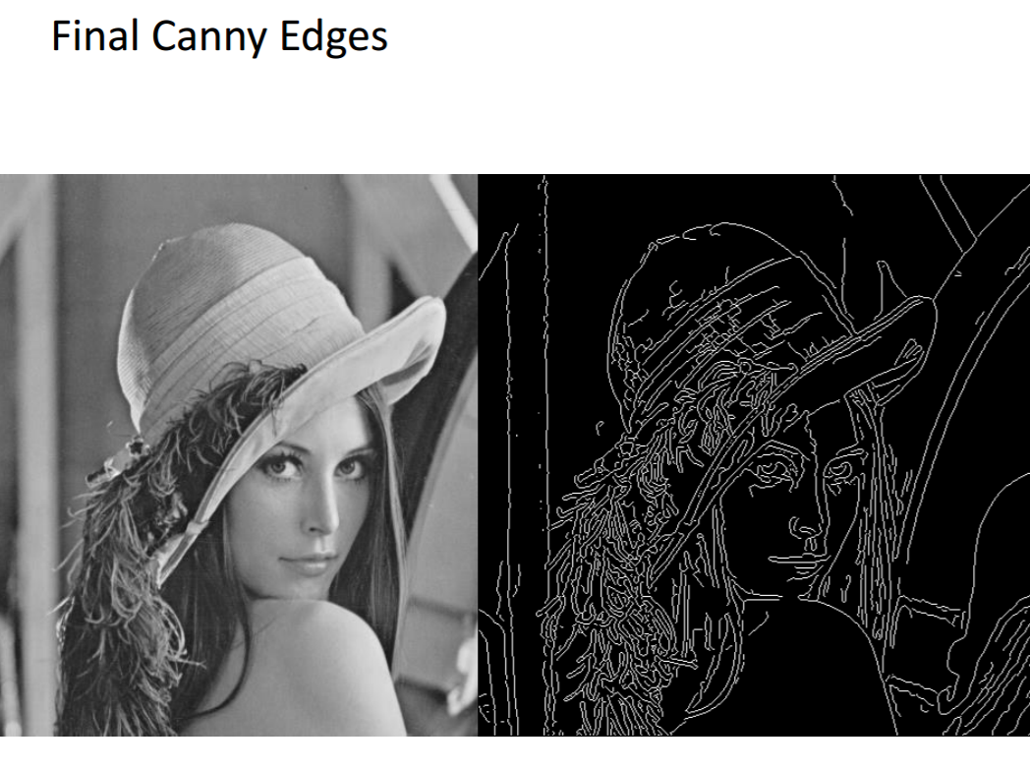
Credit: James Hays

Slide 34
Recap: Canny edge detector
Filter image with derivative of Gaussian
Find magnitude and orientation of gradient
Non-maximum suppression:
Thin wide “ridges” down to single pixel width
Linking and thresholding (hysteresis):
Define two thresholds: low and high
Use the high threshold to start edge curves and the low threshold to continue them
MATLAB: edge(image, ‘canny’);
>>help edge
Source: D. Lowe, L. Fei-Fei

Slide 35
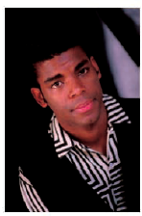

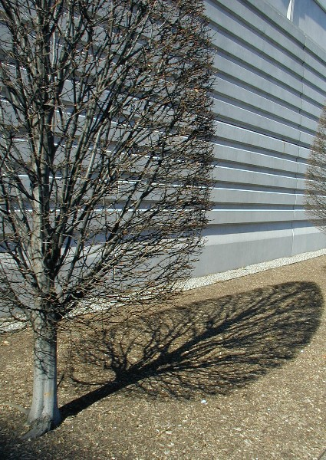

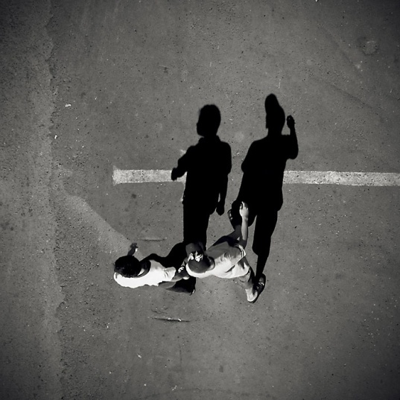

Low-level edges vs. perceived contours
Background
Texture
Shadows

Slide 36






Image gradients vs. meaningful contours
image
human segmentation
gradient magnitude
Berkeley segmentation database: http://www.eecs.berkeley.edu/Research/Projects/CS/vision/grouping/segbench/
Slide: S. Lazebnik

Slide 37

Berkeley Segmentation Data Set
David Martin, Charless Fowlkes, Doron Tal, Jitendra Malik
Credit: David Martin

Slide 38


Slide 39


Slide 40

Learn from humans which combination of features is most indicative of a “good” contour?
[D. Martin et al. PAMI 2004]
Human-marked segment boundaries

Slide 41
Modern edge detectors are based on deep NN
Xie and Tu 2015, Holistically-nested edge detection
https://arxiv.org/pdf/1504.06375.pdf

